Slide 1
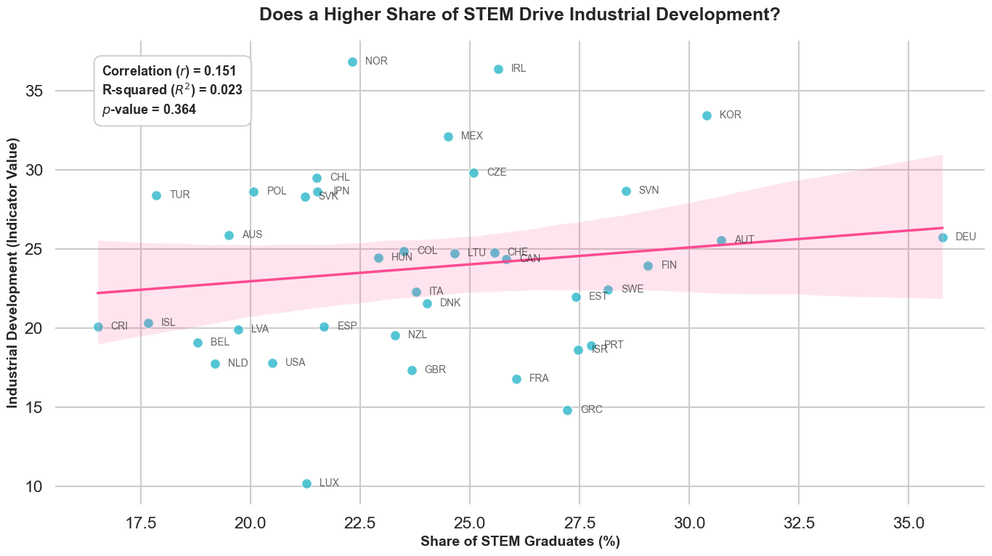
Data Visualization Pitch
Student Individual Assignment
Talents, Industry, and Richness: How are they related?
Student name: Hao Li
Student ID: 947013
Student e-mail address: l.hao1@campus.unimib.it

Slide 2
Research questions
Purchasing power, share of STEM students, Earnings, Tax, the development of industry of a country, all these concepts are concerned by people everyday, how are these concepts related to each other? This research is aimed at showing people intuitions about those concepts.
Are the share of STEM students, or their salary level, related to the development of the industry of a country?
Will the development of industry get improvement if there are more STEM students? Does the industry level imply a higher salary premium?
Is there a relation between purchasing power and the share of STEM students? And What about purchasing power after tax, and salary premium?
  It is because the country enriched by industry, or people are not willing to study STEM when they’re too rich? It is average purchasing power, or purchaing power after tax, that is affecting the share of STEM students? Or just salary premium affects it?
Does the taxing rate itself affect the development of industry of a country?
Will tax imporve or foster the development of industry?

Slide 3
About Data
Data Searching: My initial intention was “story-driven”, so I firstly decided a list of data needed, and then searched on Google, but soonly I found it was very difficult to collect just right data, after several cycle of revising and collecting, I finally collected enough data on WorldBank and OECD.
Dataset Used: Since there are too many of them, I put the data scoures in the Appendix page.
About the License: The data are all share under License of (CC-BY 4.0), claimed by World Bank and OECD. This mean I can copy, modify and distribute data in any format for any purpose, including commercial use, and of course to make derivative work, as long as I claim the data source.
Quality and Completeness: Most of situations, the data are of high quality, but there are still many gaps and obviously outliers. I have to delete many rows, and for some missing values, I used forward fill and linear regression to fill a proper value. For obviously abnormal values (taxing rate of Colombia is zero), I manually vertificate the data from other source, shockingly found it is true.
Data Cleaning: Most of cleaning work are deleting rows or filling missing values, which has been stated above.

Slide 4
Methodology
Data Collection: I manually downloaded the data from multiple sources, there’s no need of APIs or scrapers, since luckly both WordBank and OECD database provide data explorer to select data easily.
Data Processing & Cleaning: For the reason of reproducibility, all the operations on dataset are made by Python, I developed Python in Pycharm and Jupyter notebook. I also used packages like pandas, numpy to process the data. and matplotlib to generate the charts and figures.
Data Transformation: I merged different sourse of data to form a wide table, which is mainly performed by double-key merging, I used left-merging to add new blocks gradually, and finally formed a big wide table. Finally, I aggregated the wide table by Year through time-weighted average, this is aimed at improving data steability and not wasting information.
Use of AI Tools: I used mainly Gemini to help with coding and brainstrom.
Analytical Techniques: What methods did you use to derive insights? (e.g., descriptive statistics, trend analysis, comparative analysis, outlier detection)
Reproducibility: I uploaded the project on Github:https://github.com/Lihao-academic/Course_Work_Repo/tree/main/DataVisualizationProject

Slide 5
Concepts
PPP: A metric that measures the true wealth of a country's citizens by adjusting for different price levels and exchange rates, allowing for a fair comparison of purchasing power across nations.
Taxing Wedges: The ratio of total taxes and social security contributions paid by an employee compared to their total labor cost. Essentially, it is the slice of the salary pie taken by the government.
Industry value added, percentage of GDP: A macroeconomic indicator showing the share of a country's total economic output that comes from industrial sectors (like manufacturing, mining, and construction) rather than services or finance.
STEM: An acronym for the core technical and scientific disciplines that drive a nation's high-tech research, innovation, and industrial workforce.
Income of Workers in STEM (%): The income premium or relative salary of STEM professionals compared to the national average salary. For instance, a value of 118% means STEM workers earn 18% more than the average worker.

Slide 6
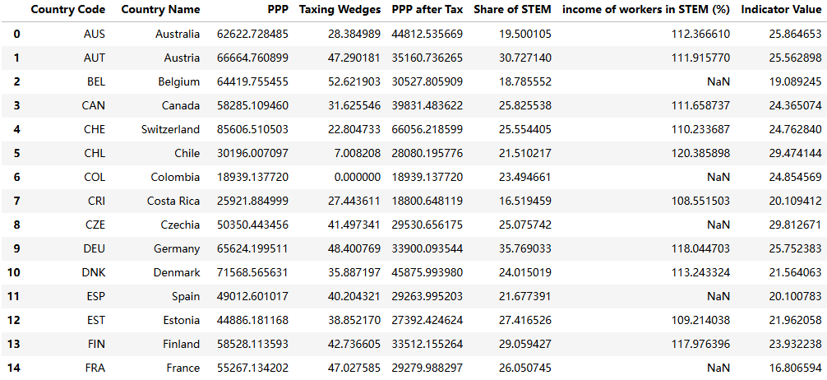
Examples of the Final Combined Table

Slide 7
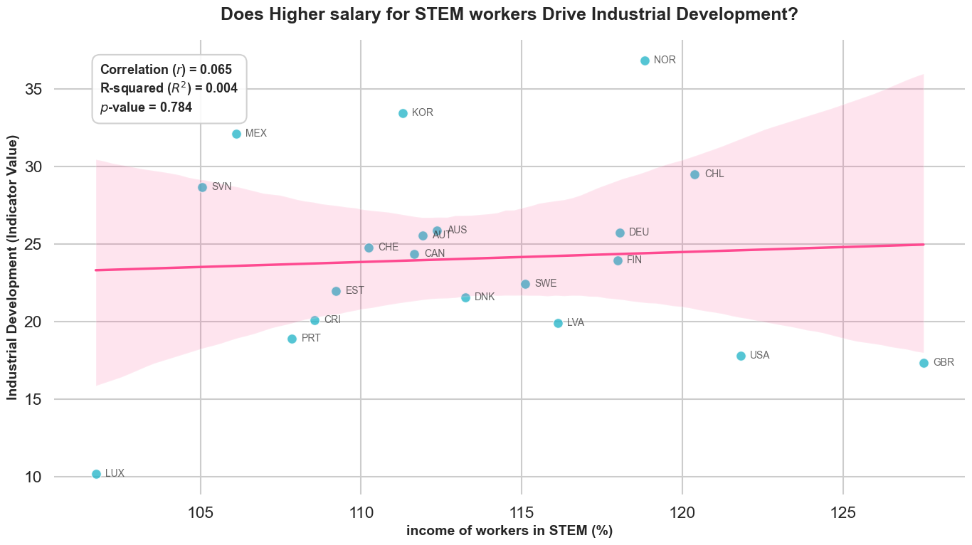
Question 1
However, the results were quite different from what we expected. In reality, there was little correlation between these variables. We can see that "Share of STEM grades" has a weak relationship with the industry indicator, although their p-values, correlations, and R-squared are not impressive. However, as we will see later, this is already the strongest correlation. Furthermore, in economics, it's inherently difficult to find clear correlations, so we reluctantly conclude that a weak correlation does exist here.
Conversely, their salaries are almost unrelated to industrial development, and industrial development does not necessarily mean a higher STEM salary premium.

Slide 8
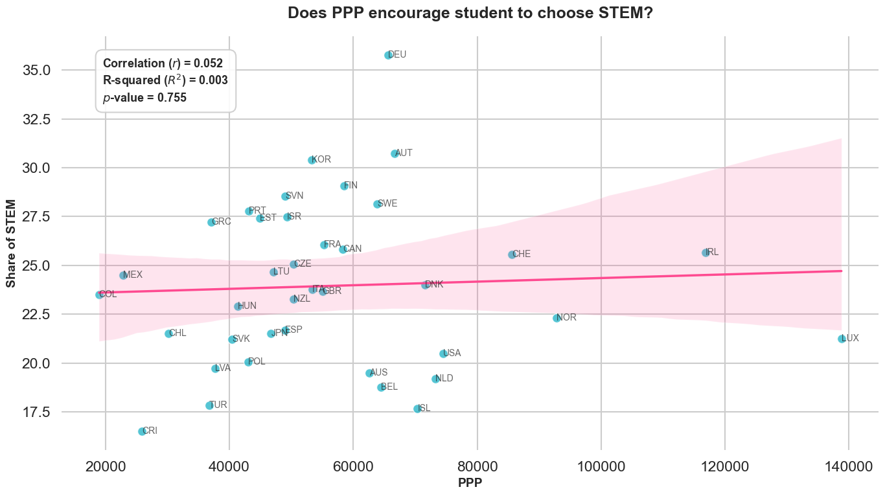
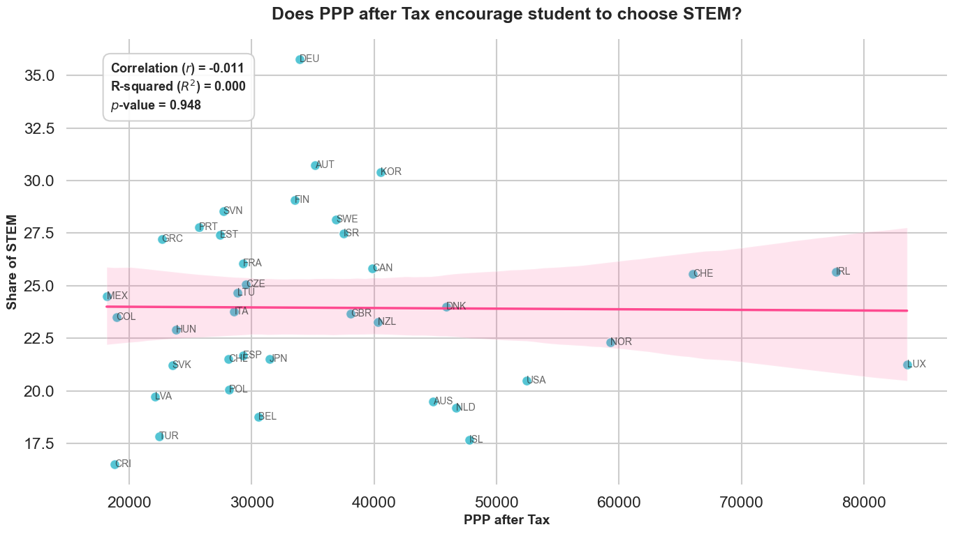
Question 2
The second question we studied was about purchasing power parity and the proportion of STEM students in a country. However, we still found that there was almost no correlation. In other words, people's average wealth level has almost no relation to their willingness to choose STEM fields, at least in OECD countries.

Slide 9
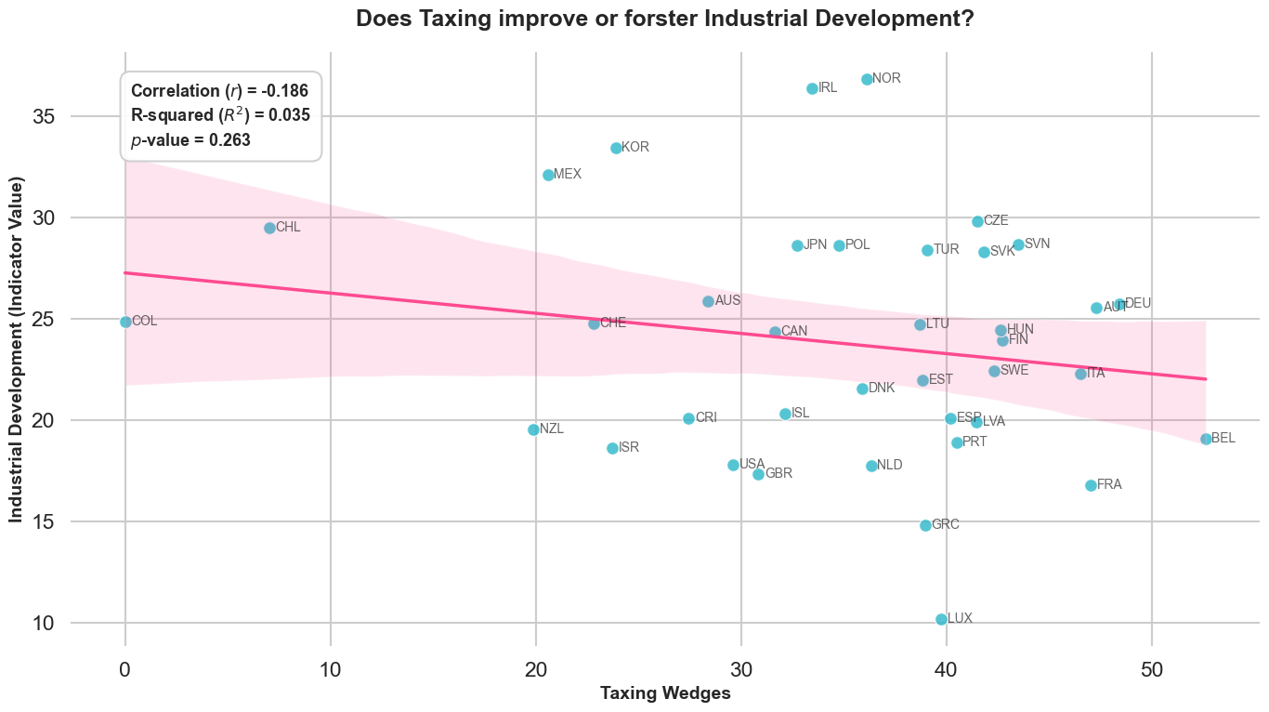
Question 3
Does the taxing rate itself affect the development of industry of a country?Will tax imporve or foster the development of industry?
In the third question, we intend to study whether national taxes on workers affect the overall industrial development of the country. The results do show a slight negative correlation, and even the p-value is relatively low. We might say that high taxes do have some negative impact on the overall industrial development of the country.

Slide 10
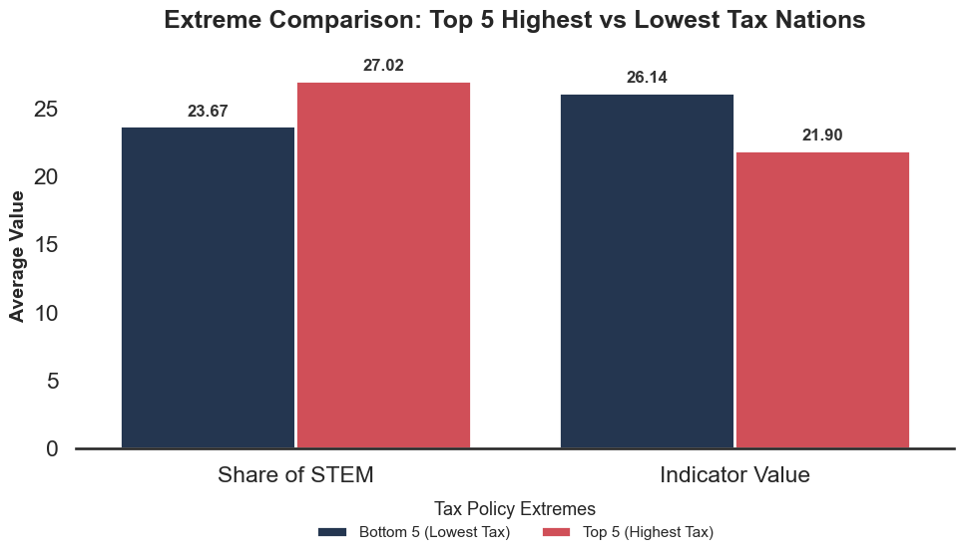
Furthermore...
Since the previous correlations were relatively weak, we specifically compared the relationship between extreme high and low tax policies and the proportion of STEM students and industrial indicators. We found that under extreme conditions, this rule is still quite obvious. However, high-tax countries do not affect students' enthusiasm; on the contrary, they may encourage more people to choose STEM. This may be because taxation plays a role in other aspects.
On the other hand, excessively high taxes can indeed hinder industrial development, as we can clearly see in the graph.

Slide 11
Conclusions & Discussion
Conclusions
The Wealth & Premium Paradox: Highly industrialized or wealthier nations (higher PPP) do not naturally produce more STEM graduates. Furthermore, massive salary premiums (e.g., in the UK or Germany) do not guarantee a proportional surge in STEM students.Beyond Macroeconomics: The lack of strong linear correlations (R² <0.2) is a major finding itself. It reveals that the "STEM Heaven" is not built on financial incentives alone; students' choices are likely shaped by complex socio-cultural factors and welfare structures rather than just money.
Discussions
Lurking Variables: Our model focuses on economic metrics, missing unmeasured variables that strongly influence education, such as immigration policies, gender gaps in tech, and cultural prestige.Sample Size & Granularity: The specific STEM income data limited our robust analysis to 21 OECD countries. Additionally, the broad definition of "Industry Value Added" might blur the differences between traditional heavy manufacturing and modern high-tech sectors.Cross-Sectional Constraints: By using a time-weighted average to handle sparse historical data, this cross-sectional study highlights structural associations but cannot definitively prove causality.

Slide 12
Appendix: Sources of the data used in the project
PPP: GDP, PPP (current international $) | Data
Taxing Wages: OECD Data Explorer • Labour taxation – OECD comparative country indicators
Share of STEM students: OECD Data Explorer • Distribution of enrolled students, new entrants and graduates by field of education
Percentage of Income of STEM workers: OECD Data Explorer • Education and earnings (EARNINGS) (full dataset)
Industry value added (% of GDP): Industry (including construction), value added (% of GDP) | Data

Slide 13
LICENCE
Slides are shared with the following license:
'Talents, Industry, and Richness: How are they related?' by Hao Li, is licensed under a CC-BY 4.0 License.

